Slide 1
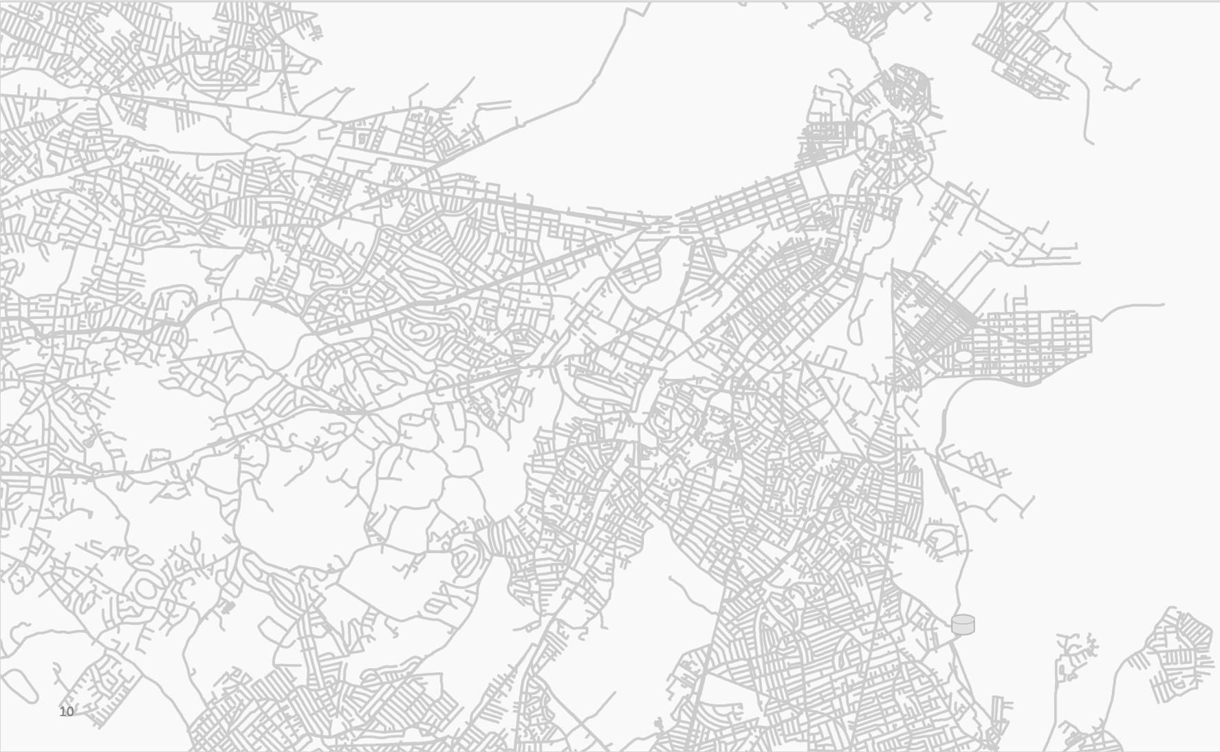


Geothermal Energy Networks:
Transforming our Thermal Energy System
January 30-31, 2024

Slide 2
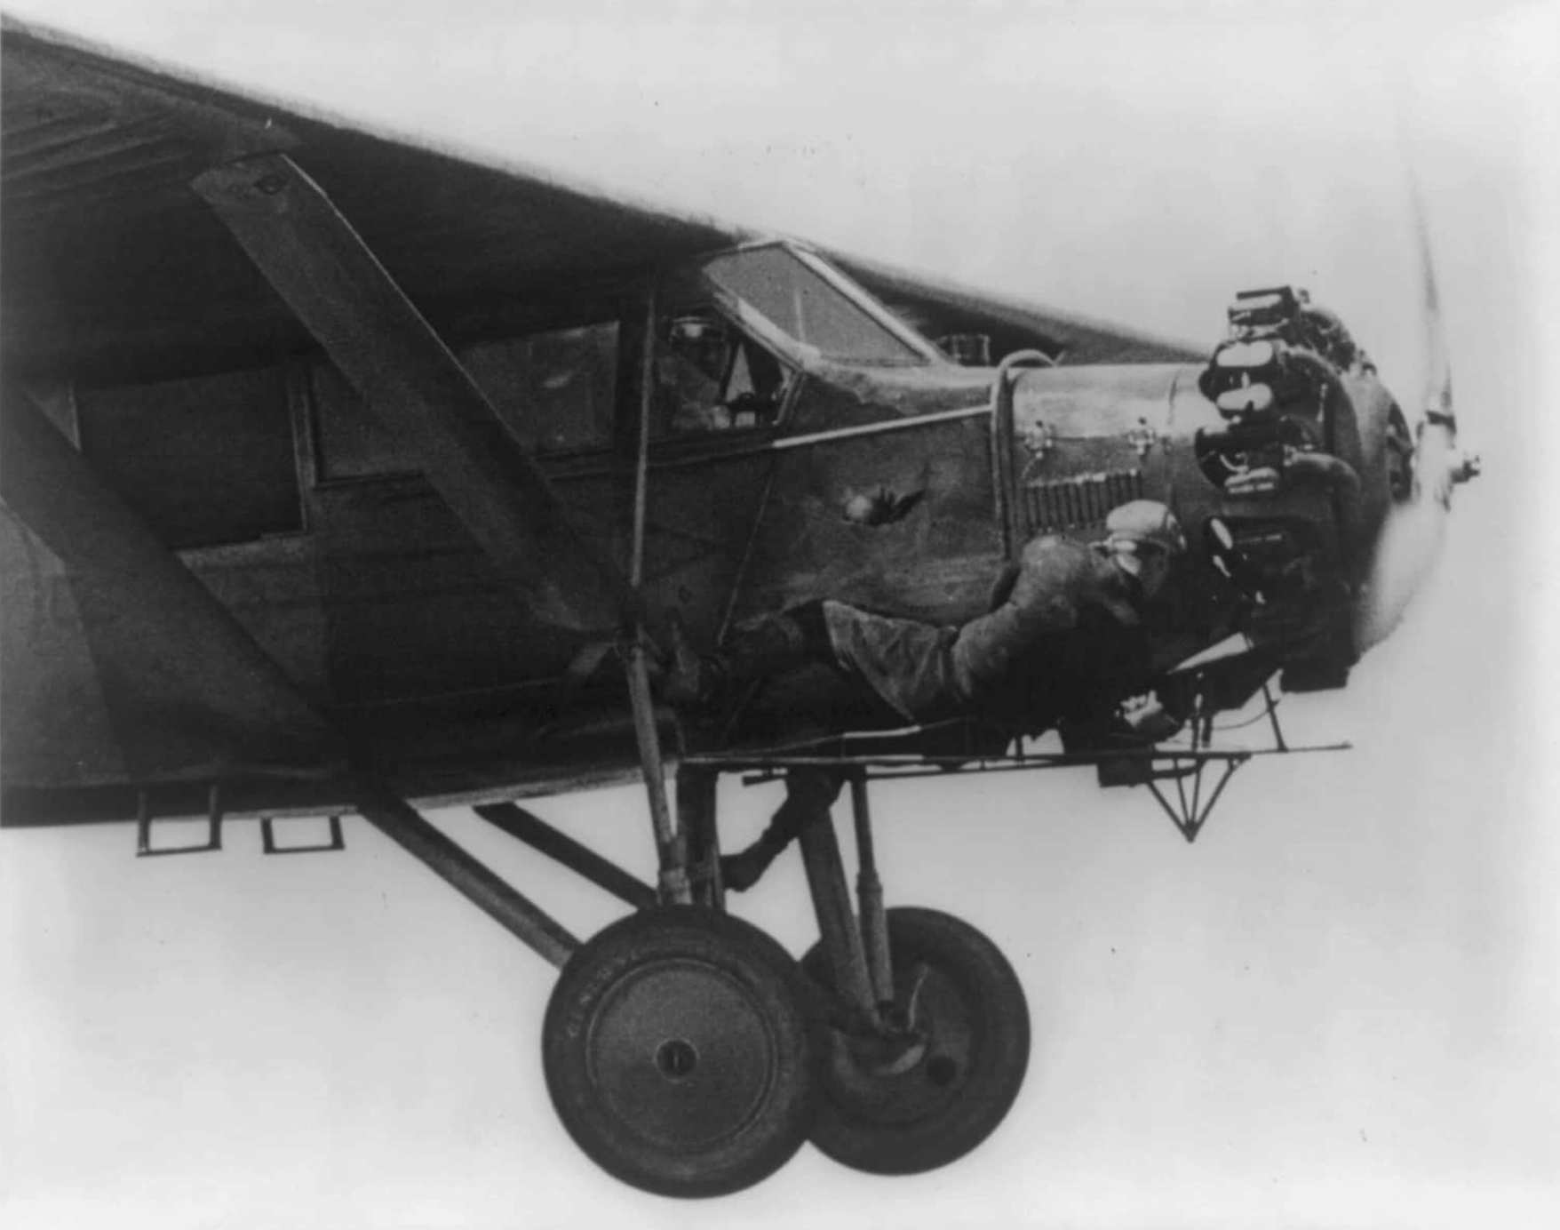
Source: public domain

Slide 3

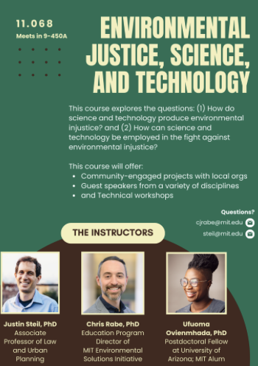

MIT Environmental Solutions Initiative (ESI)
The ESI Education Program aims to collaborate with MIT and the broader community to assess, innovate, and expand climate education across disciplinary and institutional contexts.
This workshop stems from other collaborations with HEET & ESI:
  New Course: Massive Open Online & In-Person (Department of Urban Studies and Planning)
  K-12 Curriculum on Geothermal Energy Networks (Open Learning)

Slide 4
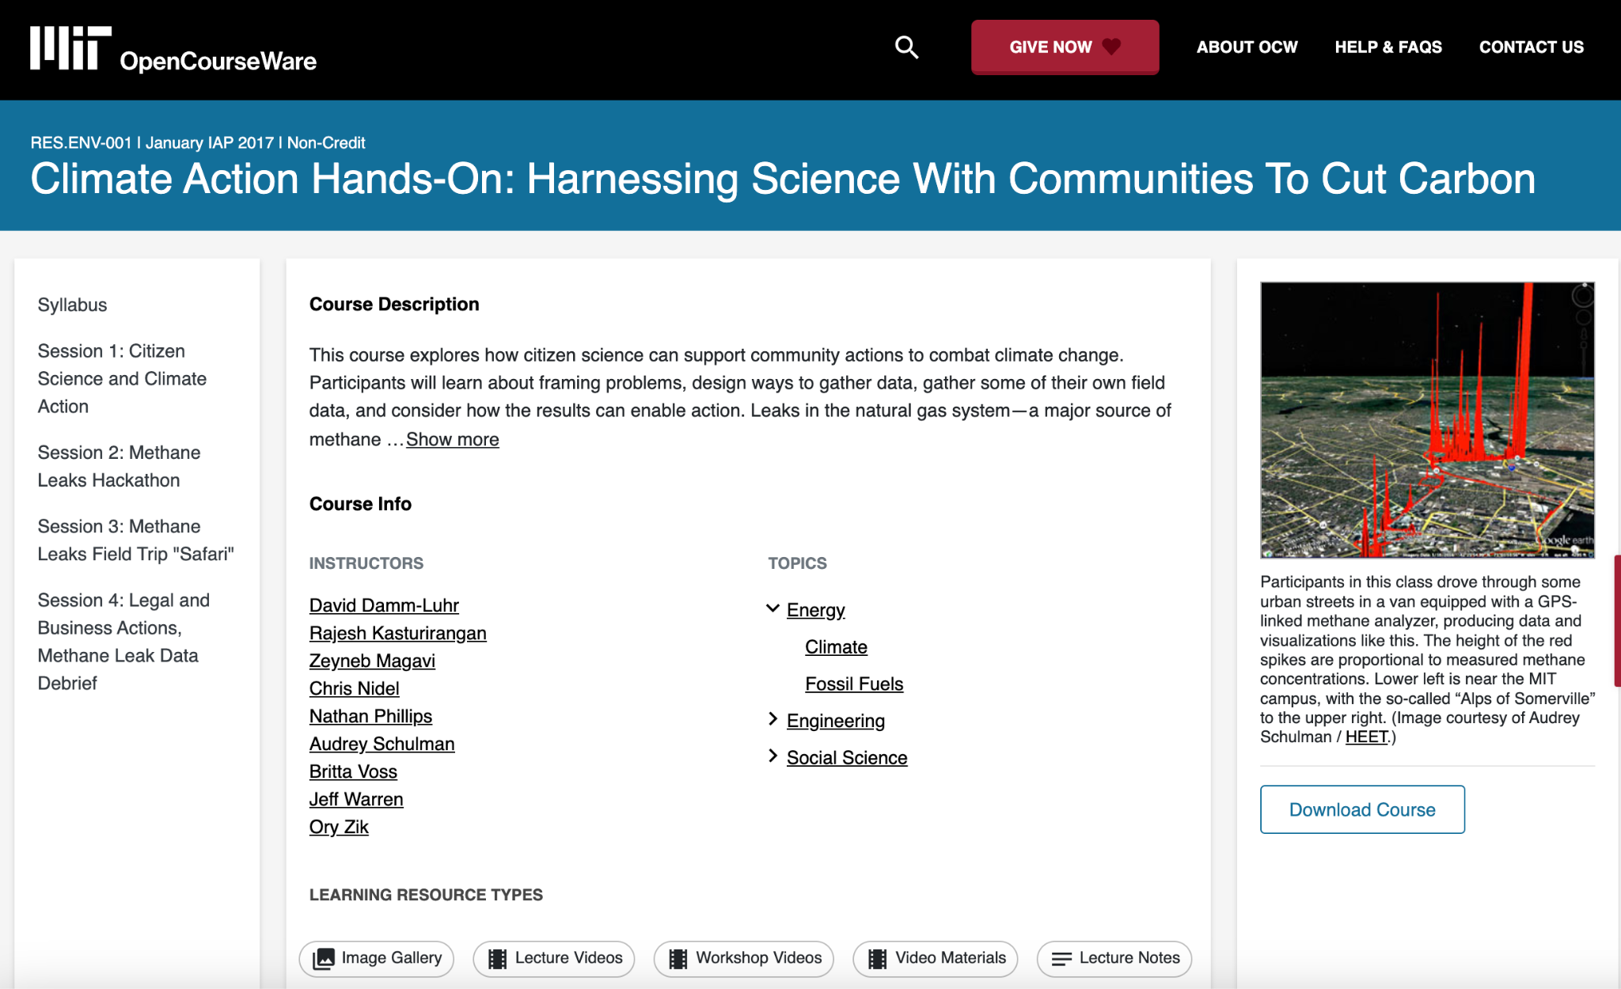
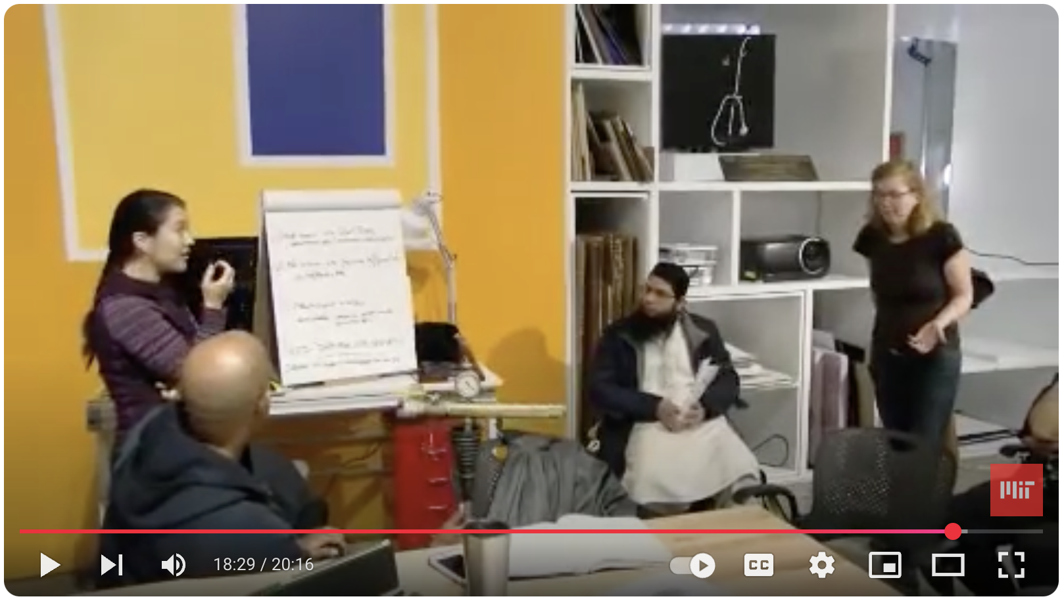
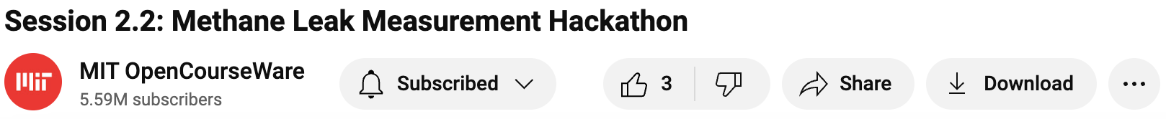

MIT OpenCourseWare
Empowering learners & educators
with free open-licensed materials
Global open knowledge ecosystem: open education+science+data+tools
OCW’s reach & impact (2024 stats)
  Website: 15M unique visits, 7.5M learners
  YouTube: 5.5M subscribers, 47M views
  70% from outside the US

Slide 5
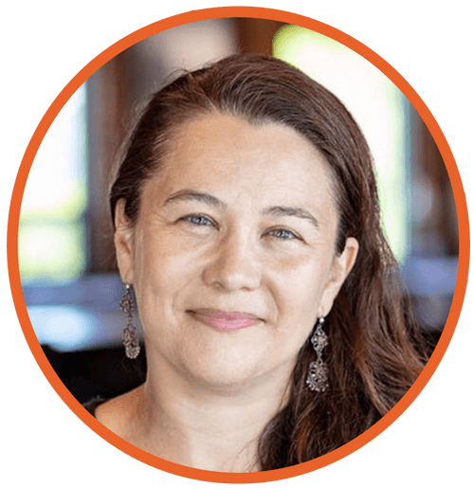
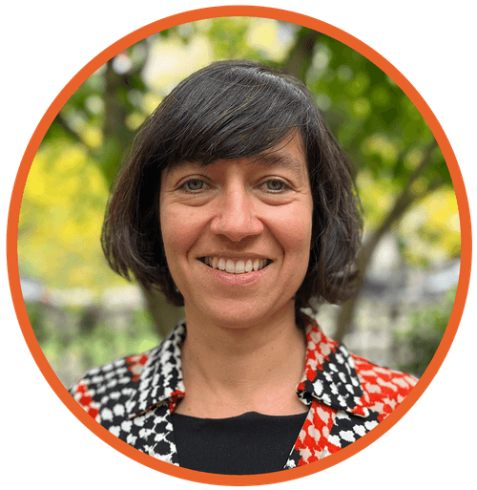
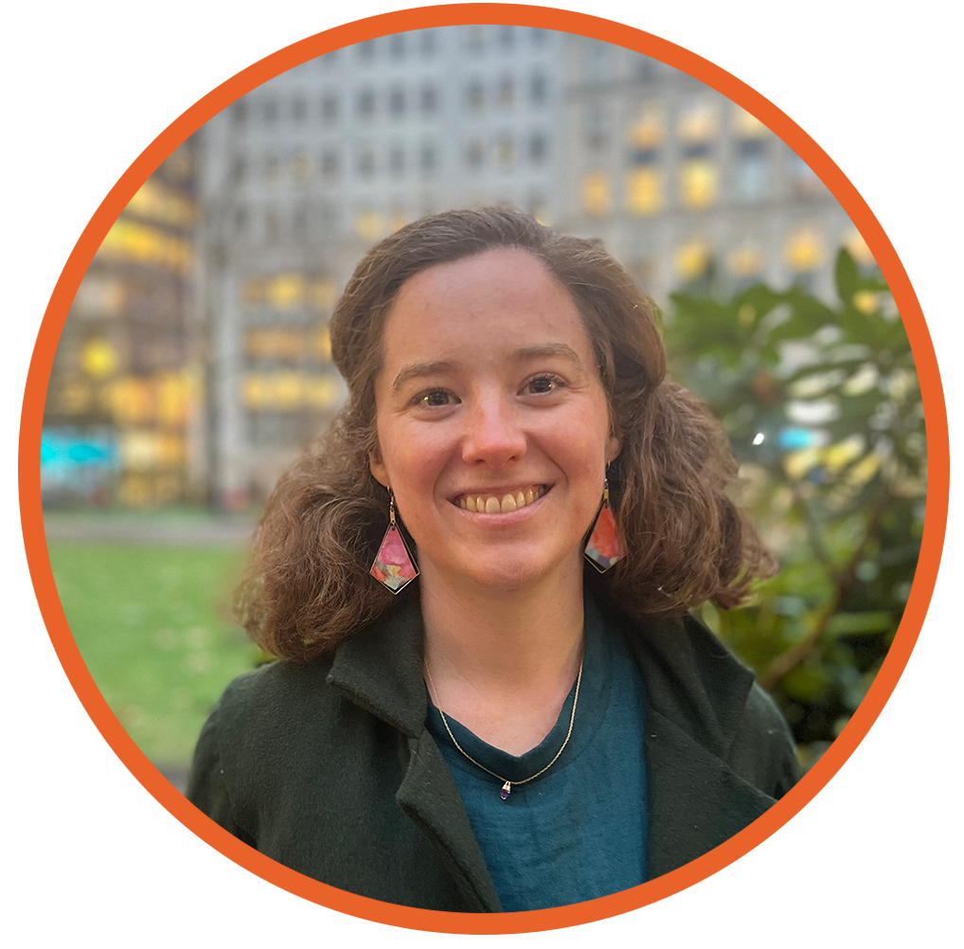
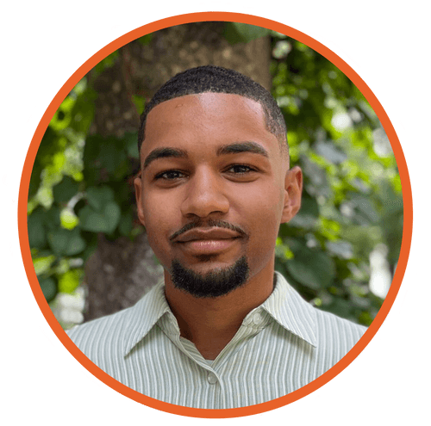

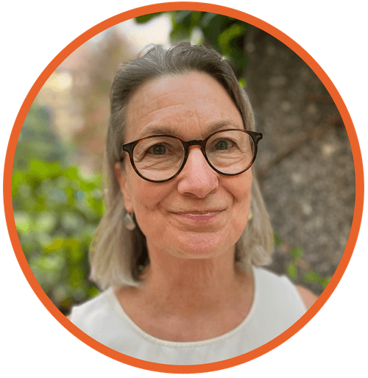
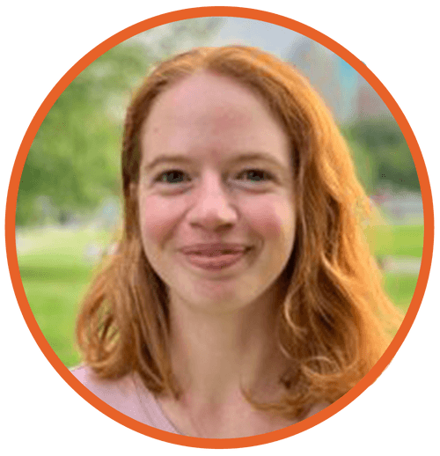
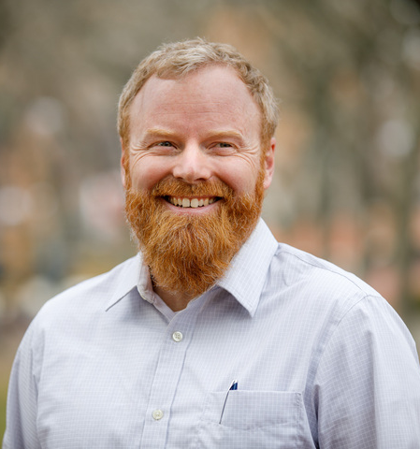
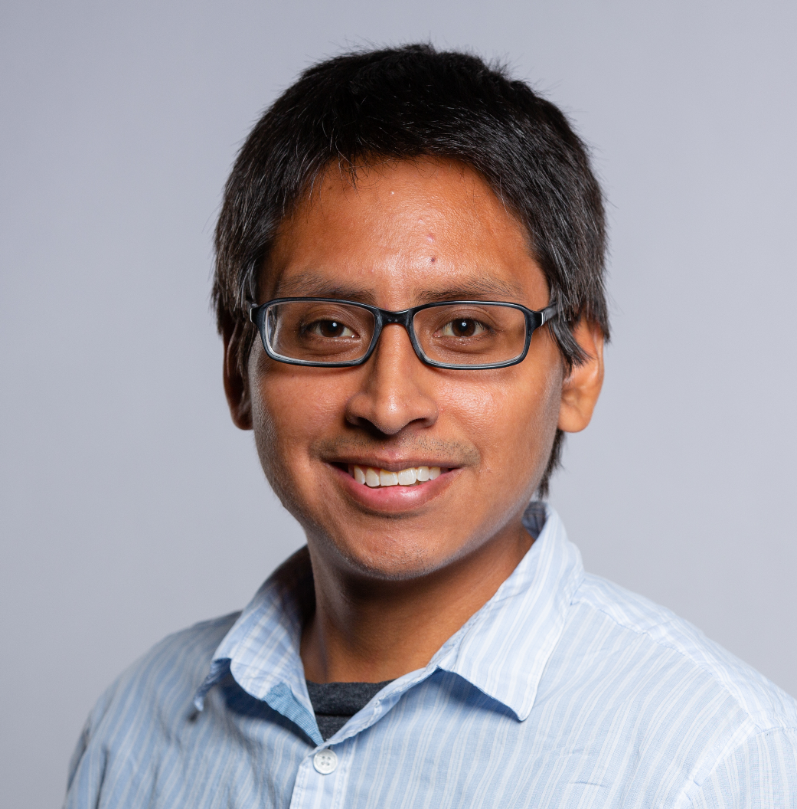
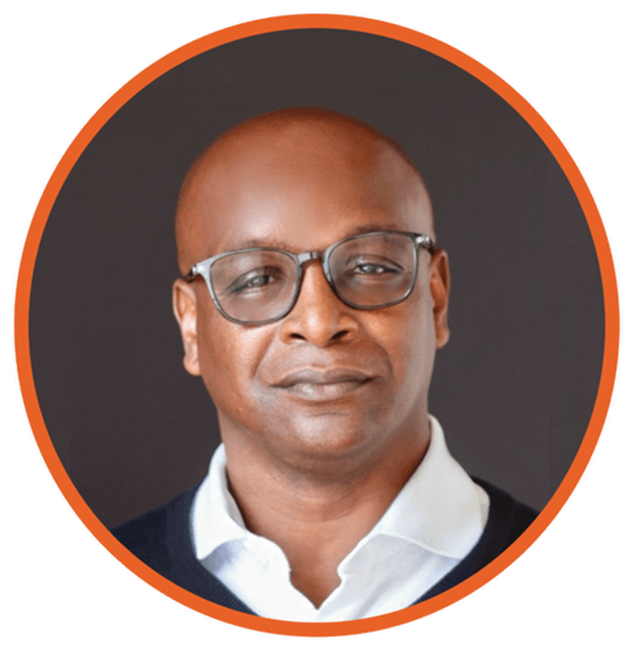

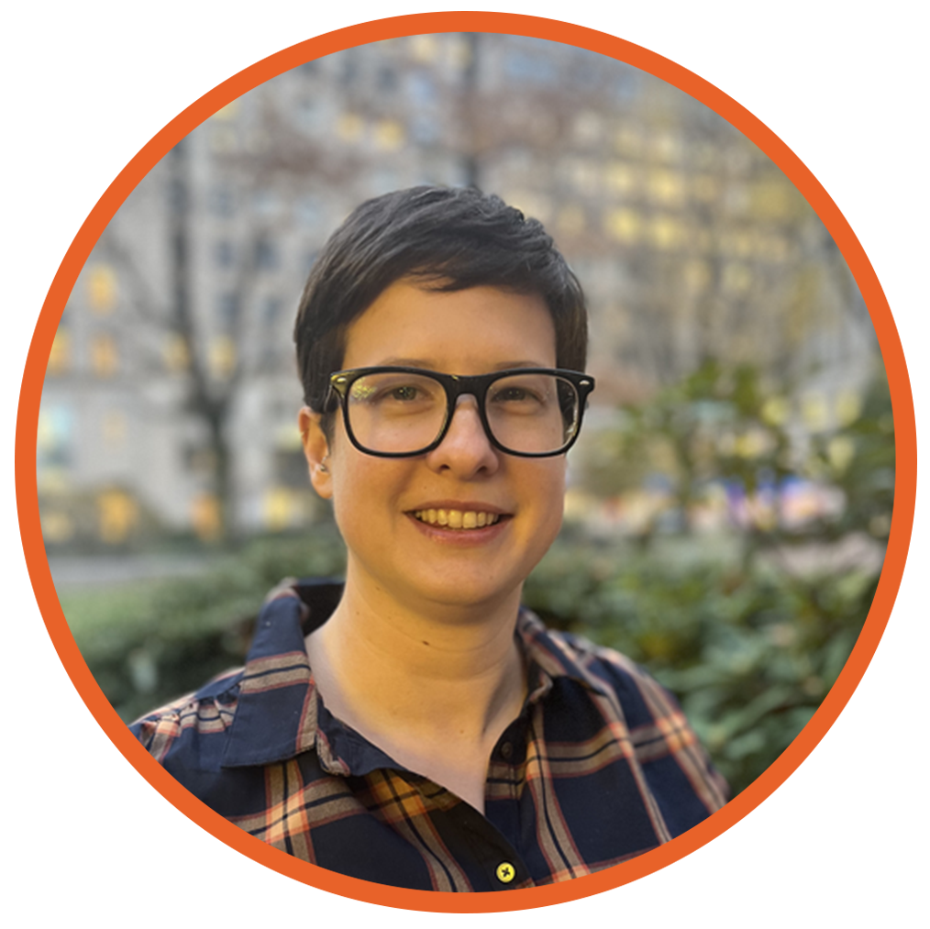
HEET team here to help over the two days:
Zeyneb Magavi
Executive Director
Isabel Varela
Science Director
Kari Bender
Assistant to ED
Eric Juma
Technology
Angie Alberto Escobar
Community Gas-To-Geo
Molly Fairchild
Healthy Homes
Rachel Wheeler
Logistics
Andrew Iliff
Policy Director
Mike Ring
Funding
Tony Berry
Communications Director
Stacy Kinnaly
Project Director
Rebecca Brenneis
Scientist

Slide 6








Course Overview
Day 1
Framing the Challenge
People Landscape for GENs
Policy Landscape for GENs
Scaling GENs
Day 2
Design Principles of GENs
Construction of GENs
GENs Research and Impact
GENs Case Studies
Notes:
We put together a course content that goes over the different sectors that need to be involved for GENs to really transform our thermal energy system.
We start with framing the challenge of our current gas system and the need to move away from using hydrocarbons for heating.
We move on to the motivations for doing GENs from a people perspective
The policy panel will discuss the evolving landscape GENs
The final panel of today will touch on how to scale these systems at city, state and country scales
Day 2 will be more technical. We start with the design principles for Ground source heat pumps and GENS and lessons learned from construction and commissioning.
Then we move on to Research on GENs and impact on the electric grid. We end with case studies of these systems, starting wth Colorado Mesa University that was built in 2008 and end with the proposed campus decarbonization project for MIT.

Slide 7
Guest Lecturers
Day 1
Zeyneb Magavi, HEET
Jason Jay, MIT
Christoph Reinhart, MIT
Jonathan Buonocore, BUSPH
Nathan Phillips, Boston University
Chris Rabe, MIT
Kelsey Wirth, Mothers Out Front
Lorig Charkoudian, MD State Delegate
Ryan Murphy, Climate Jobs
Ania Camargo, BDC
James Van Nostrand, Chair of DPU MA
Sanjeev Kumar, European Geothermal Council
Nikki Bruno, Eversource Energy
Don Lessard, MIT Emeritus
Hela Cheikhrouhou, IFC, World Bank Group
Day 2
Connor Dacquay, GeoFease
Nick Fry, Jacobs
Brian Urlaub, Salas O'Brien
Garen Ewbank, GreyEdge Group
Mark Metzner, Endurant Energy
Brock Yordy, Geothermal Drilling Association
Eric Bosworth, Eversource Energy
Xiaobing Liu, ORNL
Isabel Varela, HEET
Juliet Simpson, NREL
Cary Smith, Sound Geothermal Corporation
Mark Metzner, Endurant Energy
Jay Egg, EggGeo
Susan Murcott, MIT
Notes:
ISABEL?
29 Guest lecturers:
Universities, community based organizations, regulators, European Geothermal Council, World Bank, Engineering design firms, drillers, gas utilities and national labs.

Slide 8



Housekeeping
This course is being recorded for sharing freely with the world through MIT OpenCourseWare
Each session has brief presentations
Q&A at the end of each session - please participate !
First time offering this course
Evolving content - please provide ideas and feedback !
Notes:
Curt,
Isabel (or Curt)
Zeyneb

Slide 9
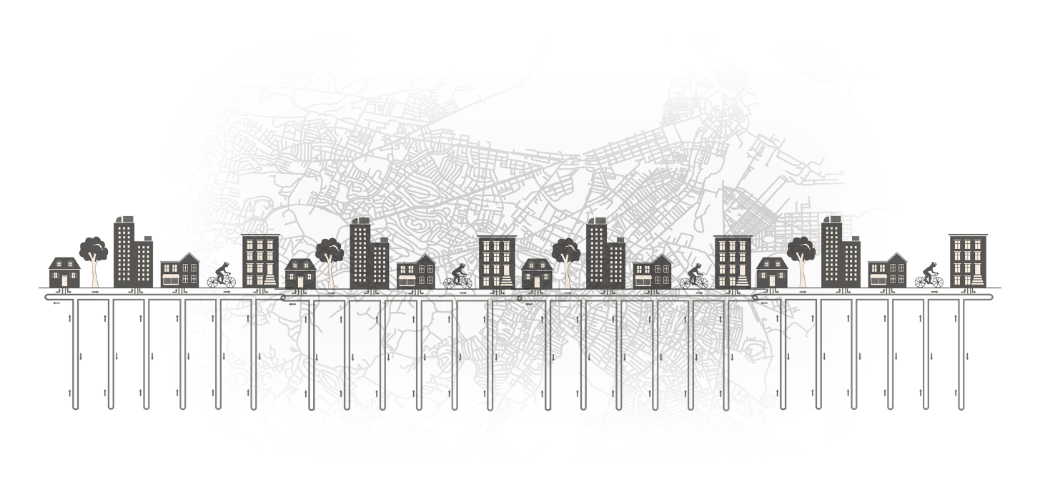
#ThinkThermalTogether

Slide 10
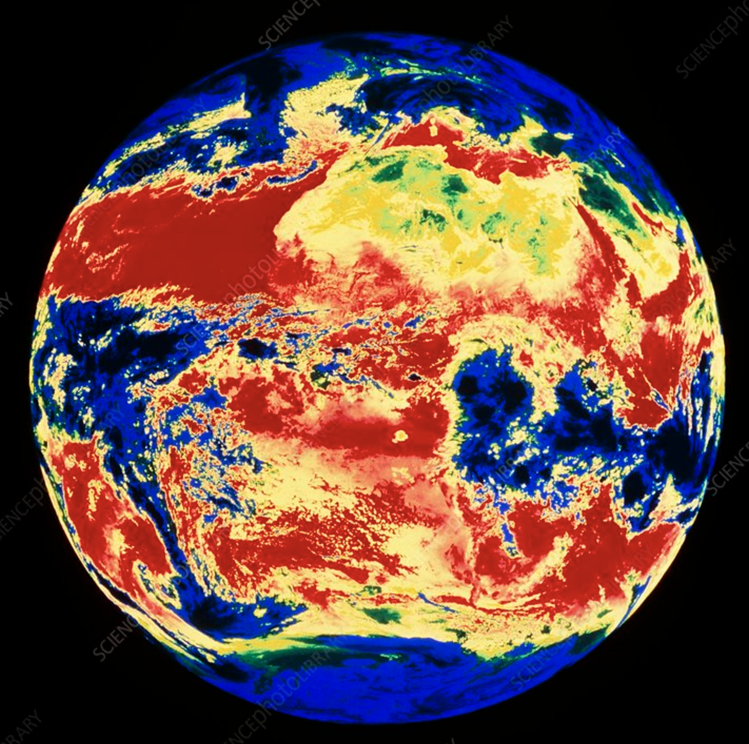
THINK THERMAL ?
“The technical potential of geothermal would be more than enough to meet all heat demand in Africa, China, Europe, Southeast Asia, and the United States.”
- IEA December 2024
Notes:
Zeyneb

Slide 11
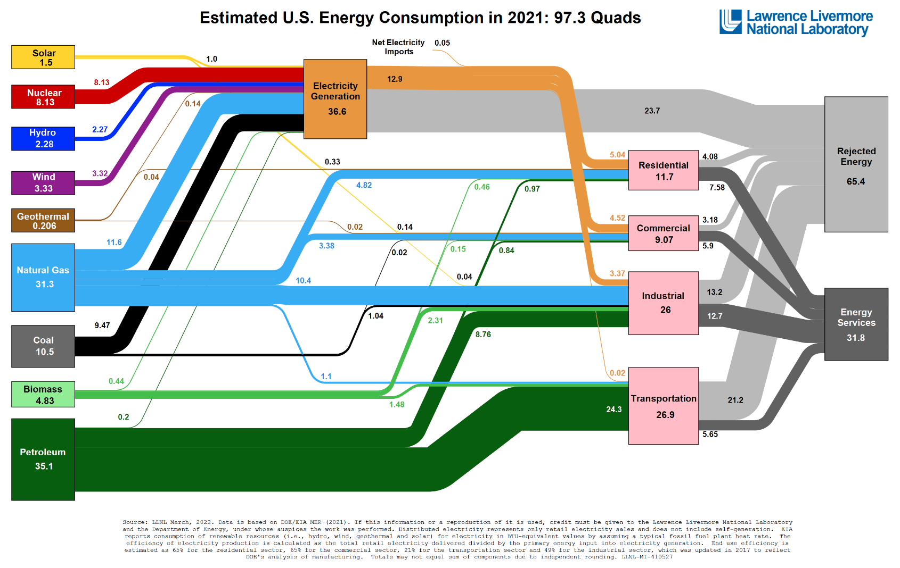

The majority of the energy we use is wasted, much of it is
Thermal energy.
Source: public domain
Notes:
Zeyneb

Slide 12
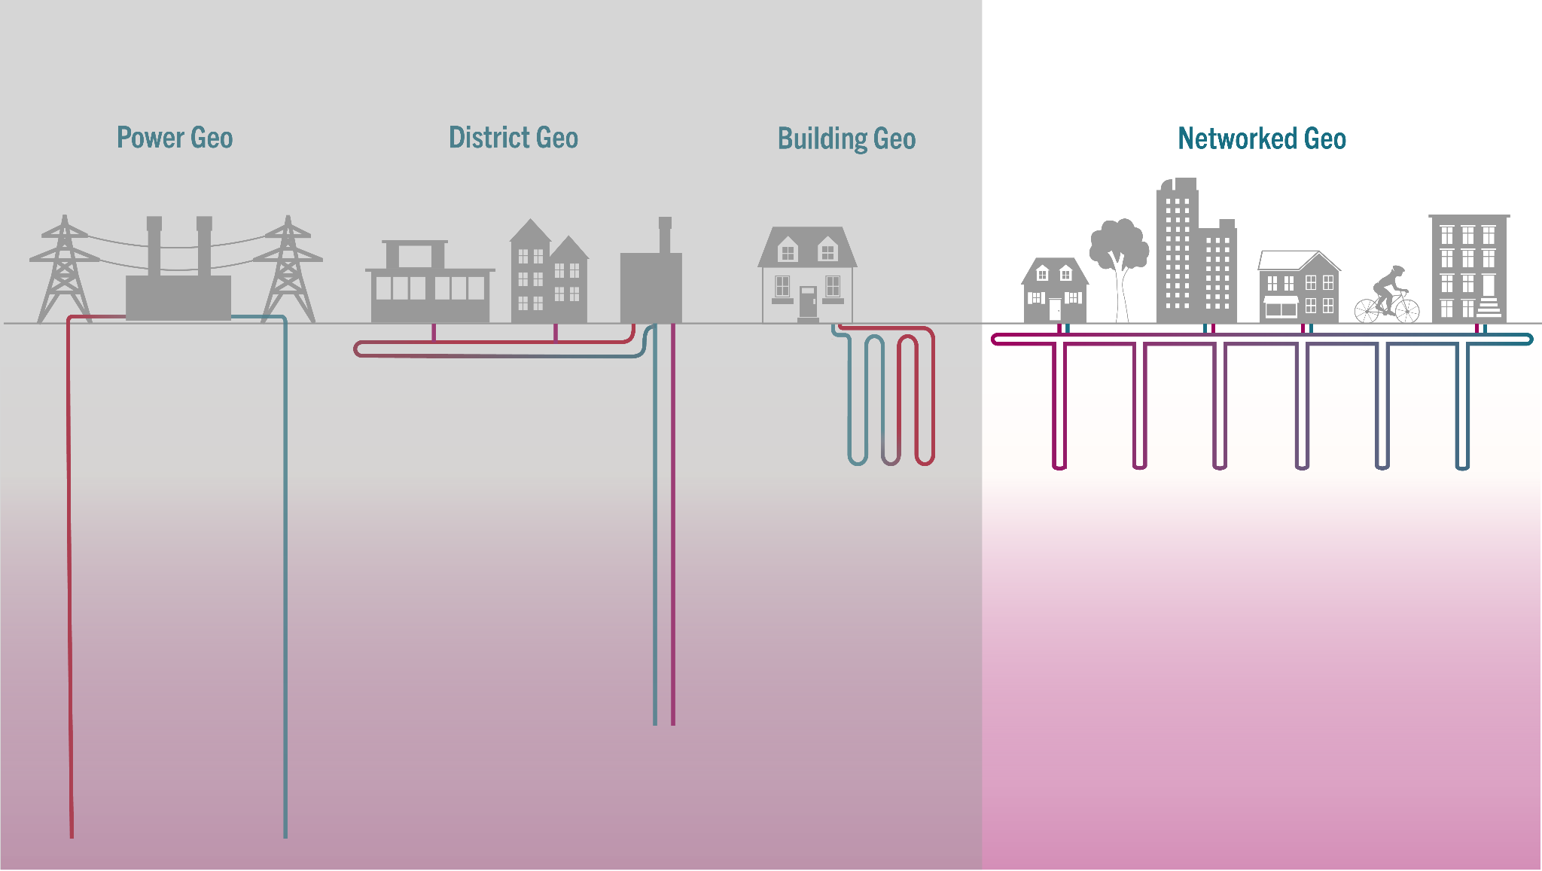
GEOTHERMAL ?
All Geothermal Technologies
provide STABLE non-intermittent energy
Shallow or Deep
Ambient or Hot
Everywhere or Not
UTILITY-SCALE ELECTRICITY
(Geo Power)
DISTRICT
HEAT
(Geo Direct Use)
UTILITY-SCALE
HEAT & COOLING
(Geo Network)
HEAT & COOLING
(Geo Heat Pump)
Geo Power
~ 45℉ to 65℉
~ 80℉ to 200℉
~ 250℉ and up
Notes:
Zeyneb

Slide 13
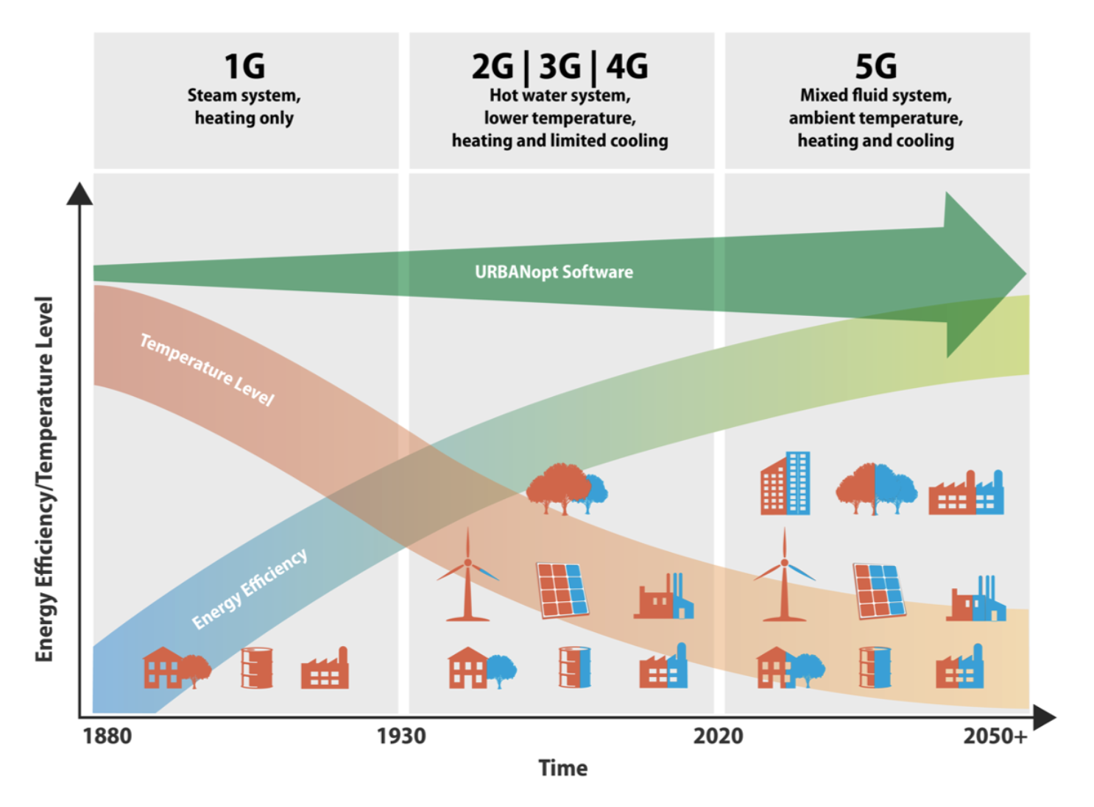
DISTRICT ?
A simplified diagram of district energy from NREL (U.S. National Renewable Energy Labs)
Source: public domain
Notes:
Zeyneb

Slide 14
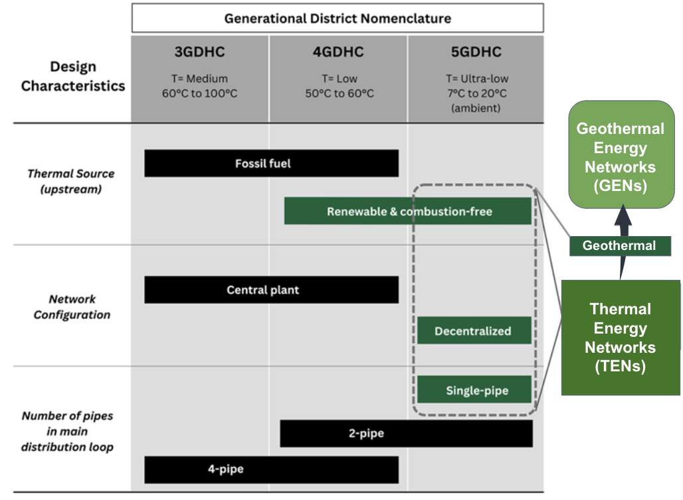
ENERGY NETWORK ?
Geothermal Energy Networks (GENs)
are a subset of
Thermal Energy Networks (TENs)
which are a subset of
5G Districts.
Notes:
Putting it all together in one chart – what is a thermal energy or geothermal energy network? It is a specific type of district energy that uses geothermal energy. This is provided here for your reference and was created to address the very variable and/or missing definitions in state laws and regs. Also, just because we get SO MANY questions on this. ☺

Slide 15
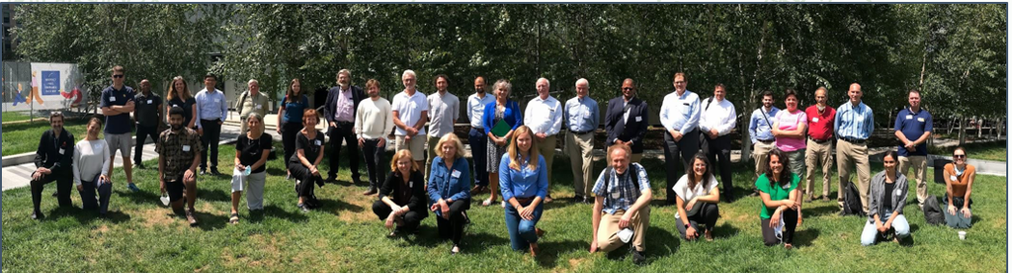
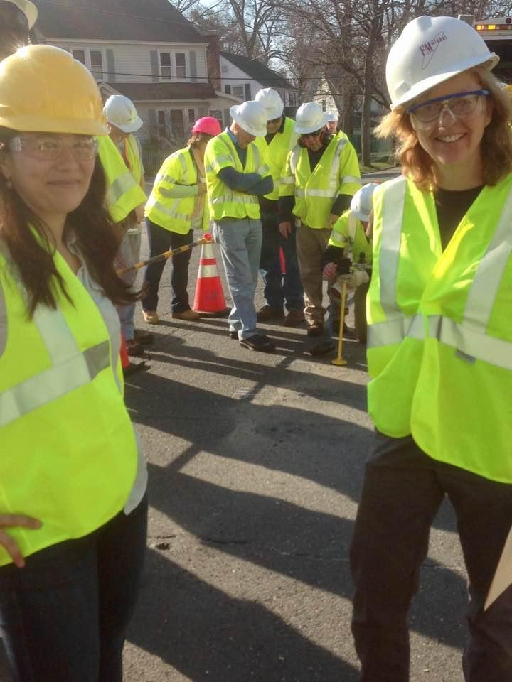

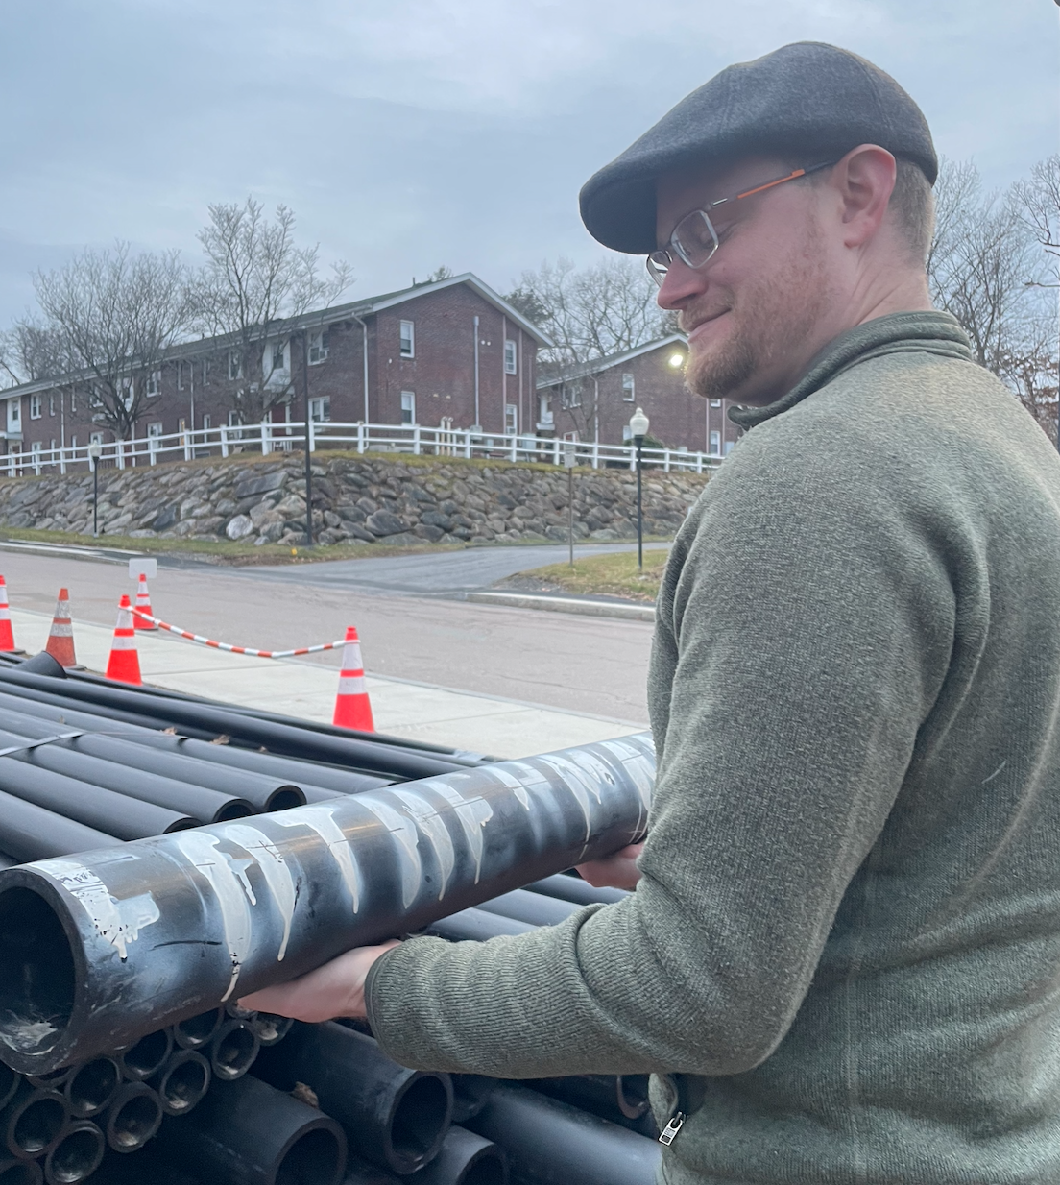
HEET’s Approach to Designing & Driving Systems Change
Used to develop Geothermal Energy Networks & the Gas to Geo
Pathway
Engage All
Stakeholders
MOVES AT
SPEED OF TRUST
Identify Leverage Points
Innovate &
Iterate
Notes:
HEET attempts to solve challenges from a systems and people-centered relationship-based approach. This is work intensive, complex, and effective.

Slide 16
GEOTHERMAL ?
All Geothermal Technologies
provide STABLE non-intermittent energy
Shallow or Deep
Ambient or Hot
Everywhere or Not
UTILITY-SCALE ELECTRICITY
(Geo Power)
DISTRICT
HEAT
(Geo Direct Use)
UTILITY-SCALE
HEAT & COOLING
(Geo Network)
HEAT & COOLING
(Geo Heat Pump)
Geo Power
~ 45℉ to 65℉
~ 80℉ to 200℉
~ 250℉ and up
Notes:
Zeyneb

Slide 17
DISTRICT ?
A simplified diagram of district energy from NREL (U.S. National Renewable Energy Labs)
Source: public domain
Notes:
Zeyneb

Slide 18
ENERGY NETWORK ?
Geothermal Energy Networks (GENs)
are a subset of
Thermal Energy Networks (TENs)
which are a subset of
5G Districts.
Notes:
Putting it all together in one chart – what is a thermal energy or geothermal energy network? It is a specific type of district energy that uses geothermal energy. This is provided here for your reference and was created to address the very variable and/or missing definitions in state laws and regs. Also, just because we get SO MANY questions on this. ☺

Slide 19
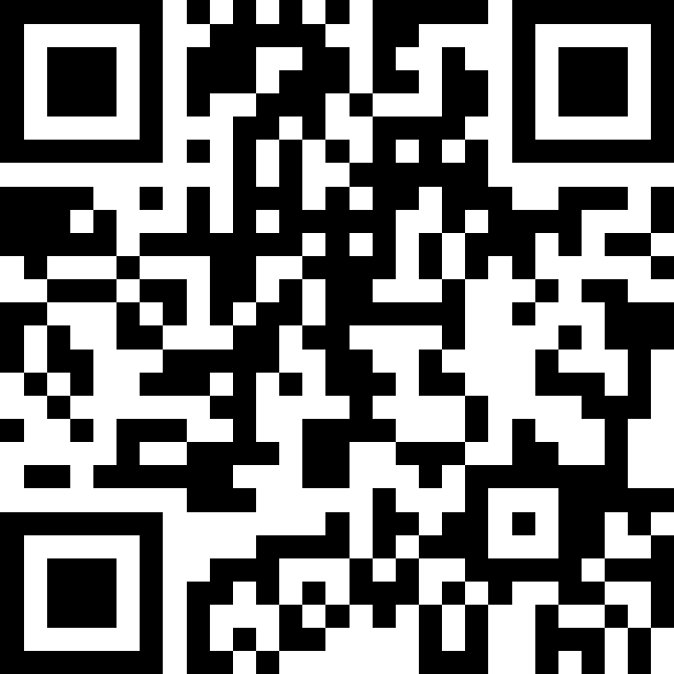

Slido Quiz !

Slide 20
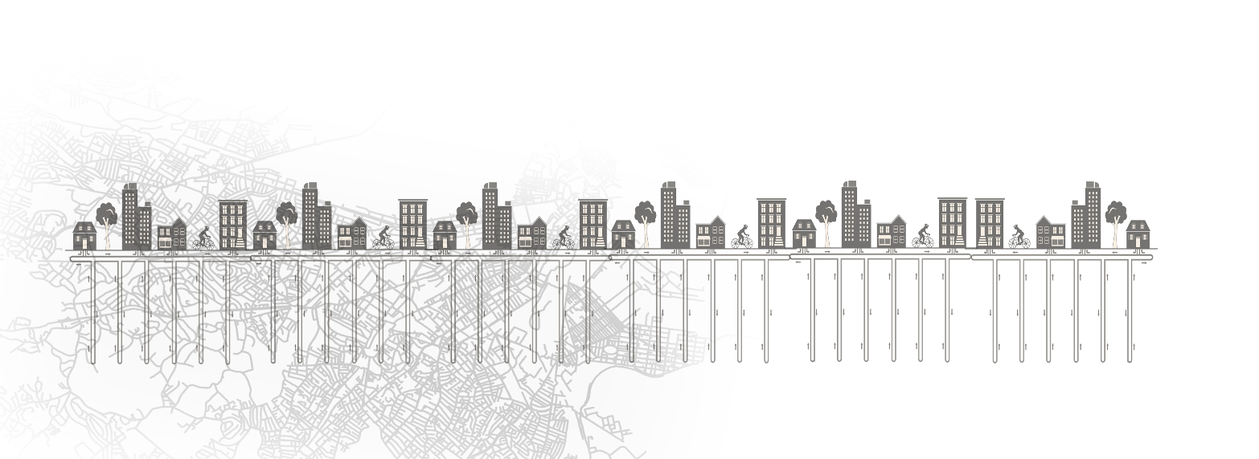
Session 1: Framing the Challenge
Moderator: Zeyneb Magavi, HEET
A Systems View of the Energy Transition and Role of Methane Emissions, Jason Jay, MIT
Carbon Reduction Pathways for Building Stocks, Christoph Reinhart, MIT
Climate, Energy and Health Nexus for GENs, Jonathan Buonocore, BUSPH

Slide 21
SLIDO: What challenge are YOU trying to solve ?

Slide 22

Coffee Break

Slide 23
Session 2: People Landscape for GENs
Moderator: Ania Camargo, Building Decarbonization Coalition
An Ecological View of the Energy Transition, Nathan Phillips, Boston University
How GENs Can Meet Environmental Justice Priorities, Chris Rabe, MIT
GENs Origins from Moms Searching to Protect Their Children's Future, Kelsey Wirth, Mothers Out Front

Slide 24
SLIDO: Brainstorm the key stakeholders

Slide 25

Lunch Break

Slide 26
Session 3: Policy Landscape for GENs
Moderator: Andrew Iliff, HEET
Policy Case Study on the WARMTH Act, Lorig Charkoudian, Maryland State Delegate
How Thermal Energy Networks (TENs) & GENs Can Meet Workforce Needs, Ryan Murphy, Climate Jobs
The Rapidly Evolving Policy Landscape for GENs & TENs, Ania Camargo , Building Decarbonization Coalition
The Potential Role of GENs in the MA Natural Gas Transition, James Van Nostrand, Chair of Department of Public Utilities Massachusetts

Slide 27
SLIDO: What is the largest policy challenge you see?

Slide 28
Coffee Break

Slide 29
Session 4: Scaling GENs
Moderator: Zeyneb Magavi, HEET
The Growth of GENs in Europe, Sanjeev Kumar, European Geothermal Energy Council
Utility Perspective on Scaling GENs, Nikki Bruno, Eversource Energy
Business Models for Deploying GENs, Don Lessard, MIT (emeritus)
Expanding GENs at a Global Scale, Hela Cheikhrouhou, International Finance Corporation, World Bank Group

Slide 30
SLIDO: Say it is a race - where will GENs get to scale first ?

Slide 31
Closing Day 1
#ThinkThermalTogether

Slide 32
Geothermal Energy Networks:
Transforming our Thermal Energy System
January 30-31, 2024

Slide 33
#ThinkThermalTogether

Slide 34
Session 5: Design Principles for GENs
Moderator: Juliet Simpson, NREL
Introduction to Geothermal Heat Pumps, Connor Dacquay, GeoFease
Systemic Differences Between Geothermal Heat Pumps and GENs, Nick Fry, Jacobs
Introduction to Design of GENs, Brian Urlaub, Salas O'Brien

Slide 35
SLIDO: What advantages does a single-pipe ambient-temp loop design provide?

Slide 36
Coffee Break

Slide 37
Session 6: Construction of GENs
Moderator: Isabel Varela, HEET
Thermal Response Tests for Geothermal Boreholes, Garen Ewbank, GreyEdge Group
Emerging Code & Standards for Ambient Temperature Loops, Mark Metzner, Endurant Energy
Introduction to Drilling Geothermal Boreholes, Brock Yordy, Geothermal Drilling Association
Constructing and Commissioning a GEN, Eric Bosworth, Eversource Energy

Slide 38
SLIDO: What innovations are most needed to build more, faster, for less ?

Slide 39
Lunch Break

Slide 40
Session 7: Researching GENs & Impacts
Moderator: Zeyneb, HEET
Discussion on existing grid impact knowledge with guests, Xiaobing Liu, ORNL
Learning from GENs, Isabel Varela, HEET
Techno-Economic Modeling of GENs, Juliet Simpson, NREL

Slide 41
SLIDO: What data is needed to unlock investment and scaling?

Slide 42
Coffee Break

Slide 43
Session 8: Case Studies of GENs
Moderator: Nick Fry, Jacobs
Colorado Mesa University, CO, Cary Smith, Sound Geothermal Corporation
Framingham, MA, Mark Metzner, Endurant Energy
Penn South Cooperative, Manhattan, Jay Egg, EggGeo
MIT Thermal Energy Network (MITTEN) Plan, Susan Murcott, MIT

Slide 44
SLIDO Plusses, Deltas, and Key Learnings

Slide 45
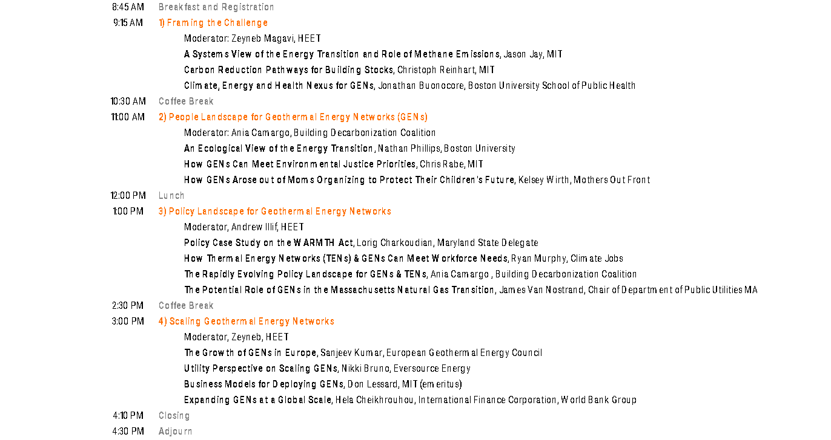
THANK YOU to the Guest Lecturers - Thursday

Slide 46
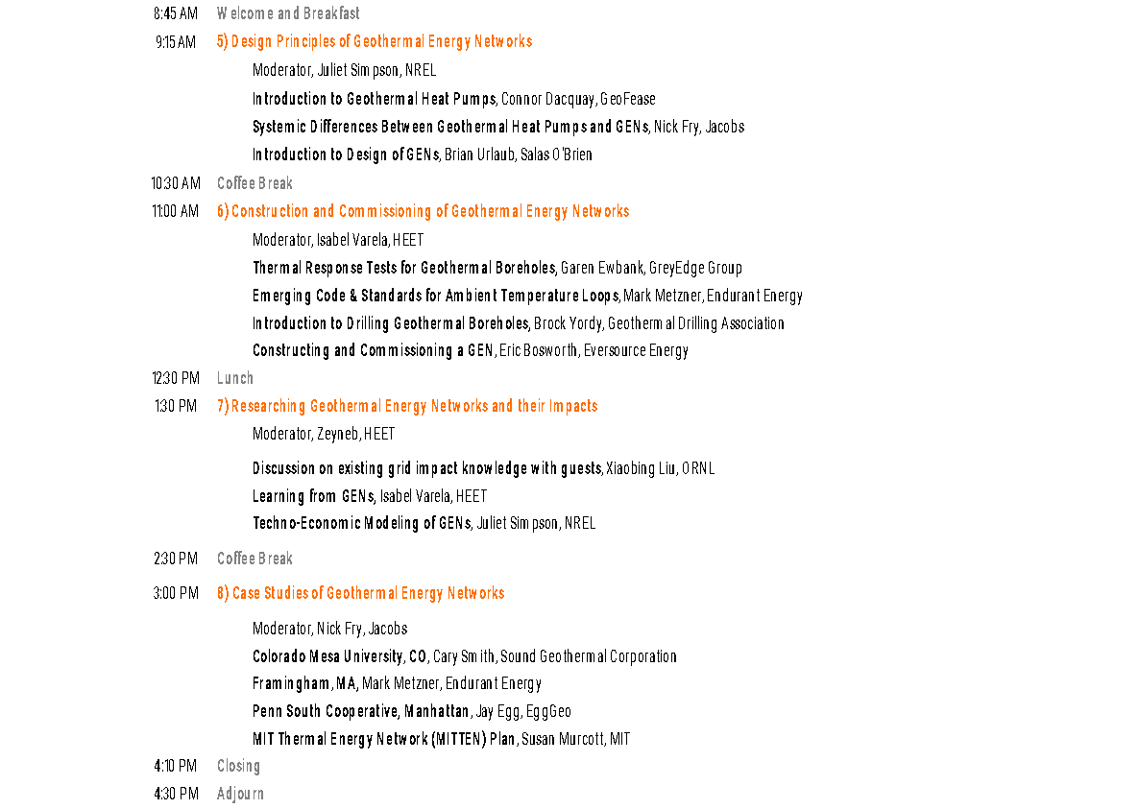
THANK YOU to the Guest Lecturers - Friday

Slide 47
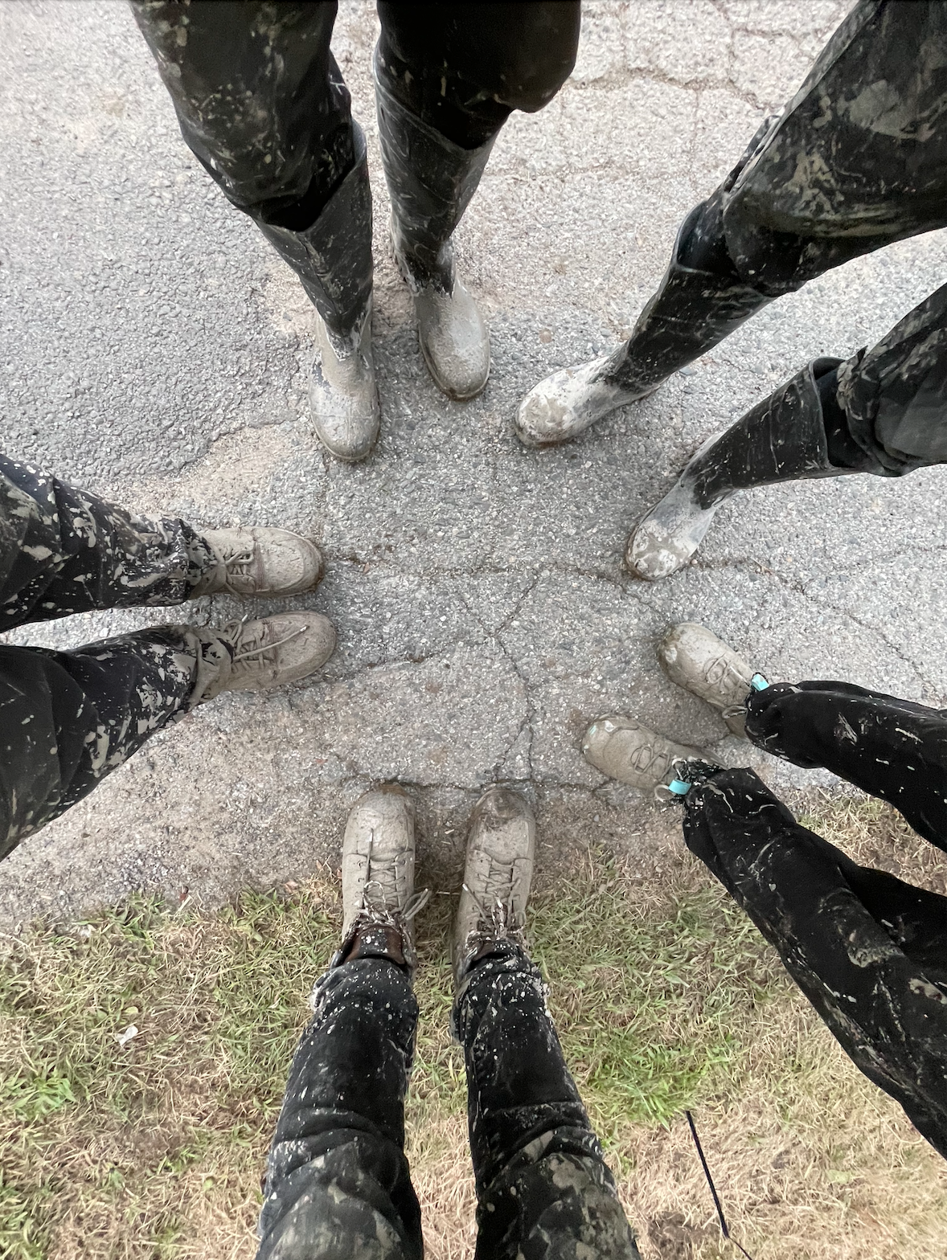
THANK YOU to ALL of you for #ThinkingThermalTogether

Slide 48
Until Next Year !
#ThinkThermalTogether

Slide 49
MIT OpenCourseWare
https://ocw.mit.edu/
RES.ENV 007 Geothermal Energy Networks (GENs): Transforming our Thermal Energy System
IAP 2025
For information about citing these materials or our Terms of Use, visit: https://ocw.mit.edu/terms.

